Slide 1





01
Travel Tales
Enhance your journey, one story at a time

Slide 2
Aim & Scope
02
Enhance car experience: encourage meaningful dialogues among passengers to create a more enjoyable and socially connected travel experience.
Customized Interest: leverage individual interest profiles to spark conversations aligned with each occupant's preferences.
Adapting to Evolving Interests: dynamically adjust and update individual interest profiles over time.

Slide 3
State of the Art
03
Existing Work: "A multimodal approach for modeling engagement in conversation" by Morreale et al. [1] in Frontiers in Computational Neuroscience (2023).
Engagement Definition: The approach defines engagement for conversations using varied indicators like facial expressions and gestures.
Engagement Assessment: their method combines prosodic, mimo-gestural and features for better engagement prediction, outperforming previous models.
Foundation for Our Project: Our project adopts a similar multimodal approach, integrating audio signal sentiment, speech rate, duration, and user video sentiment for estimating engagement levels.

Slide 4
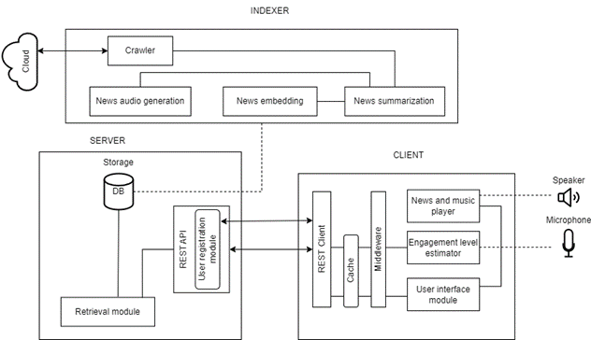
Architecture
04
Client:
REST client module
Engagement Level Estimator module
User Interface module
News and music player
Indexer:
News Crawling
News summarization
News embedding
News audio generation
Server:
REST API endpoints
User registration Module
Retrieval Module

Slide 5
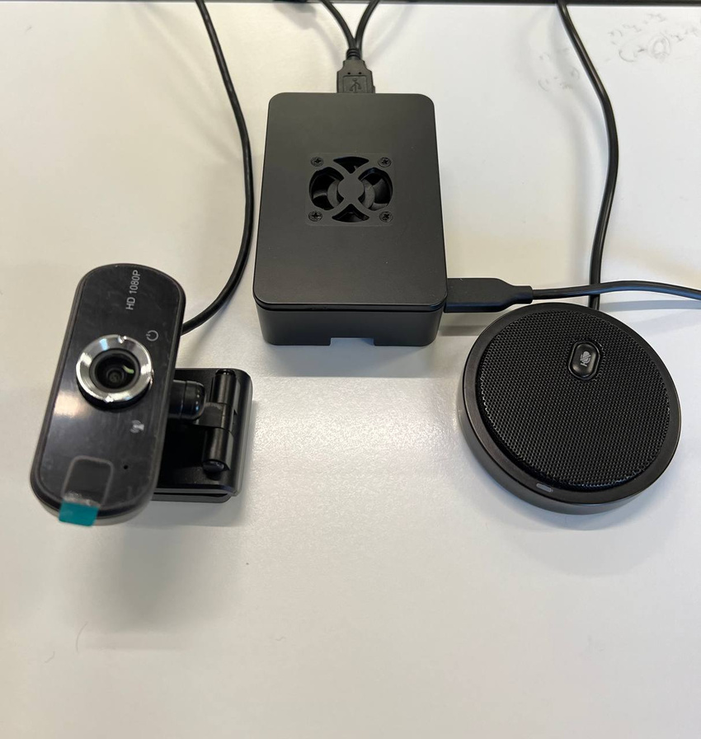
Hardware setup
Client:
Raspberry Pi 4 Model B 4 GB RAM
USB 2.0 Microphone
USB 2.0 Webcam
05
Server:
Remote pc

Slide 6
Indexer - RSS Feed and MORSS
06
News articles are obtained through RSS Feed
In order to obtain full articles morss.it service is used
Url of used RSS Feed:
rss_url_list =[
"https://morss.it/:clip/https://www.huffpost.com/section/us-news/feed",
"https://morss.it/:clip/feeds.bbci.co.uk/news/rss.xml",
"https://morss.it/:clip/https://www.huffpost.com/section/business/feed",
"https://morss.it/:clip/https://www.huffpost.com/section/celebrity/feed",
....
"https://morss.it/:clip/https://therevealer.org/feed/",
"https://morss.it/:clip/https://thepoliticalinsider.com/feed/",
"https://morss.it/:clip/https://www.teachertoolkit.co.uk/category/podcasts/feed/",
"https://morss.it/:clip/https://humornama.com/feed/",
"https://morss.it/:clip/https://www.sciencedaily.com/rss/top/science.xml",
"https://morss.it/:clip/https://www.newscientist.com/subject/space/feed/"
]

Slide 7
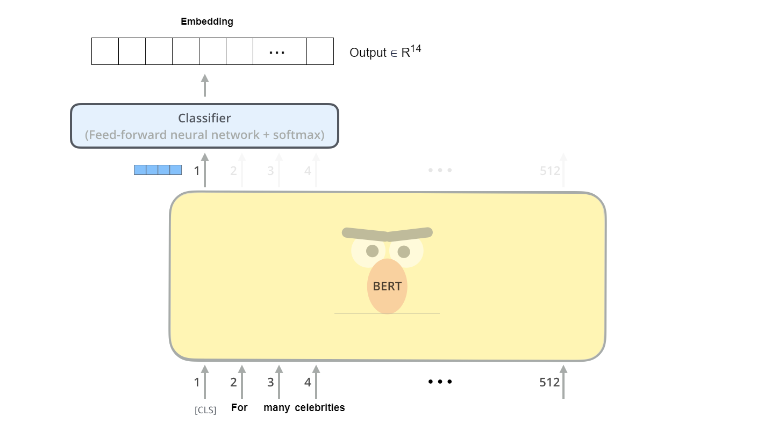
Indexer - News Embedding Model
A Distil-BERT model is trained on a dataset with 14 categories (Dataset Link)
Probability distribution vector is used as news embedding
News are placed into a 14-dimensional space
07

Slide 8
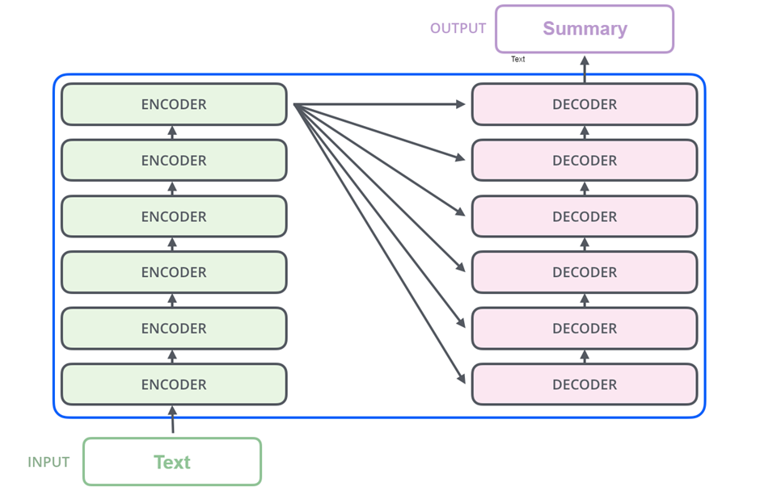
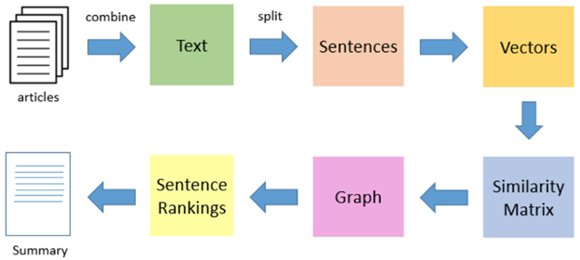
Indexer - LSA and Transformer summarization
08
The summarization model consists of two components:
Transformer-based summarization, using the BART architecture, generates short summaries from key phrases
LSA Summarize extracts key sentences for a concise version

Slide 9
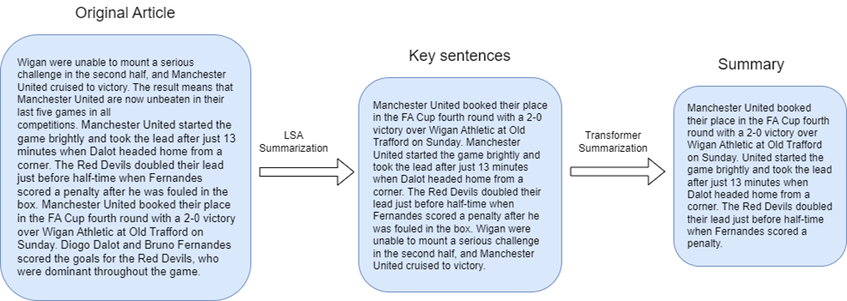
Indexer - Summarization example
09
Below a summarization example on a sport article is shown:

Slide 10
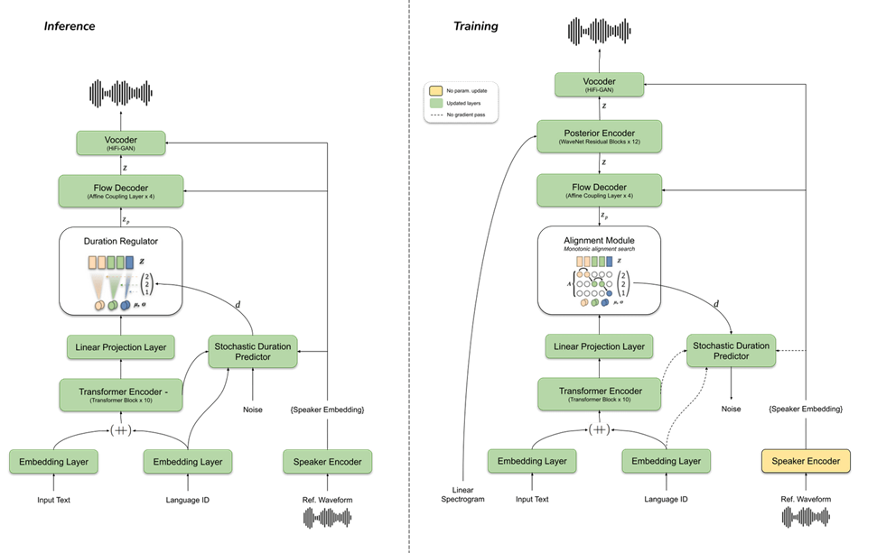
Indexer - Audio news generation with Coqui TTS
Coqui TTS utilizes advanced neural network technology natural-sounding TTS
The workflow involves:
downloading a sample voice as an .mp3 file
creating a TTS voice model based on the provided sample
using this model to generate audio news from textual input
10
The architecture of Coqui TTS requires:
Reference waveform (sample audio signal)
Language ID (language chosen for audio generation)
Input Text (the text used to create audio)

Slide 11
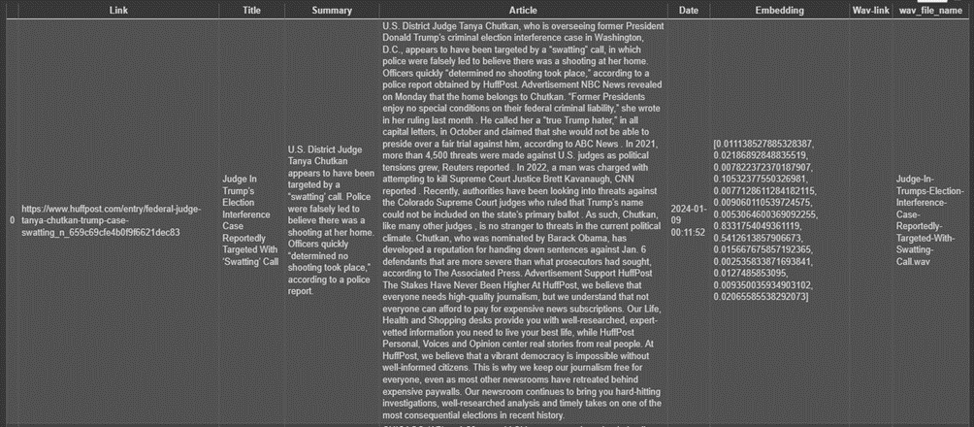
Indexer - Articles and audio collection
The Outputs of the Indexing stage are two:
A collection of News samples
A collection of Audio tracks, one for each news article summary
11

Slide 12
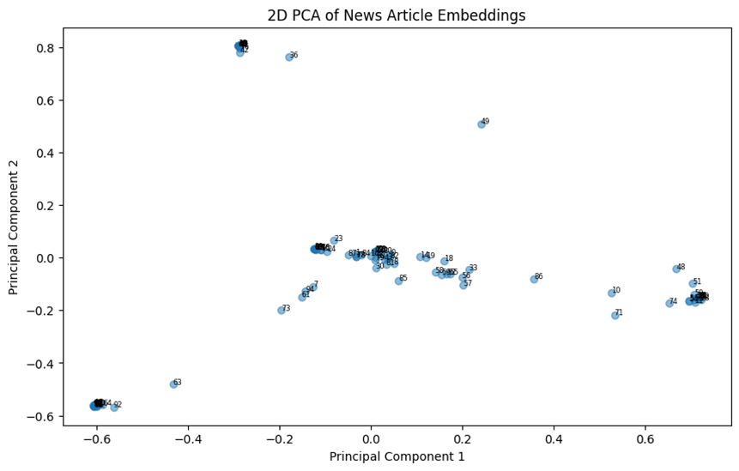
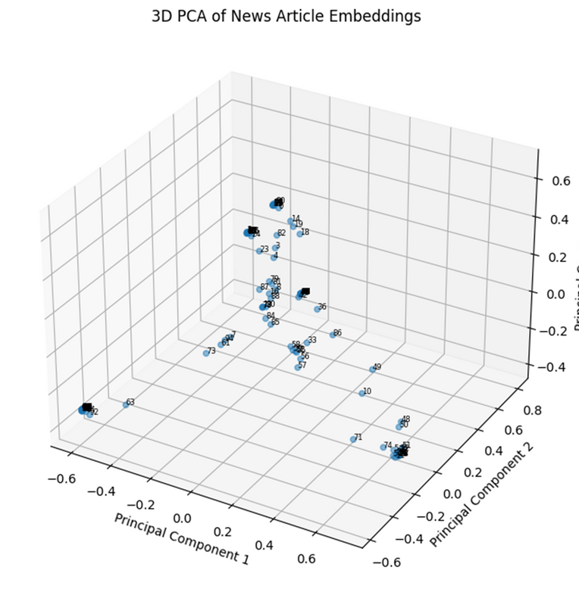
Indexer - PCA of articles collection
Below are displayed two Principal Component Analysis (PCA) plots of the news collection, both with 2 and 3 Principal Components
12

Slide 13
Server
13
Method | Endpoint | Description
GET | / | Renders the HTML page for user registration.
POST | /register | Registers a new user to the system along with audio and interests.
GET | /users | Returns the list of registered users.
GET | /speaker_profiles/<path:path> | Retrieves speaker profiles with the specified filename (username.pv).
GET | /audio-news/<path:path> | Retrieves audio news files with the specified filename.
POST | /feedback | Receives users' feedback regarding proposed news.
GET | /news_suggestion | Retrieves news suggestions based on given passengers' usernames.
The server is implemented through a Flask web server and exposes REST API for:
user registration
audio processing
speaker profiling
news suggestion

Slide 14
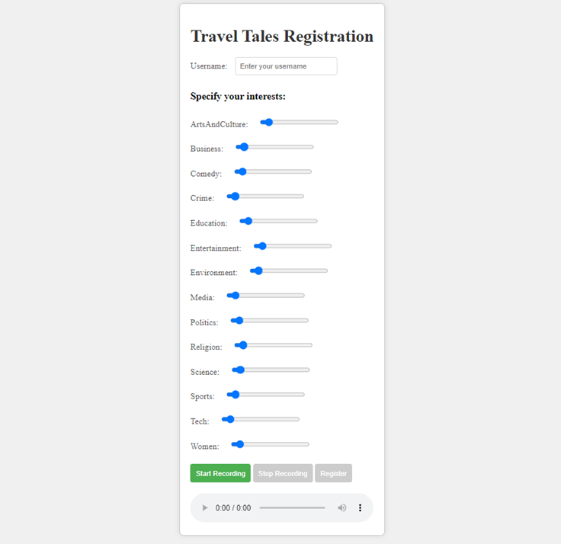
Server - Registration
14
Enter Username
Specify Interests
Start Recording
Stop Recording
Review and Playback (optional)
Submit Registration
Wait for Confirmation

Slide 15

Server - Retrieval System
15
Objective: Determine collective interests of a user group and suggest personalized news recommendations.
Input: Passenger representations (user profiles).
Output: List of news articles with maximum cosine similarity to the centroid of user representations.

Slide 16
Client
16
The client is implemented with PySimpleGUI library and consists in several modules:
News Retrieval & Player Module: in charge of managing the selection and playback of news articles in a system.
Data Visualization Module: this Module is in charge of defining a GUI window for data visualization after a news has been proposed to a group of passengers.
Feedback Estimation Module: in charge of assessing user sentiment and thus engagement feedback for a given news article. Includes:
Speaker Recognition Module: in charge of implementing the real-time speaker recognition
Audio Sentiment Classification: in charge of predicting sentiment from audio files, and estimating user engagement based on sentiment, speech rate, and audio duration.

Slide 17
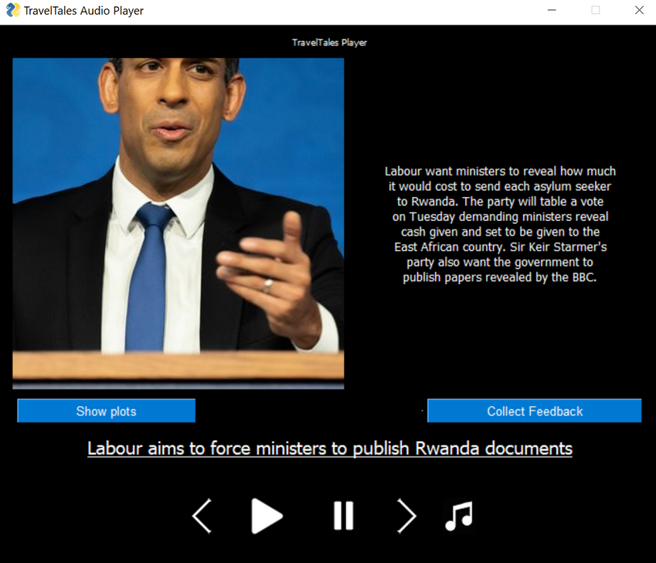
Client - News Retrieval & Player Module
17
Handles selection and playback of news articles in the system.
Communicates with the server to fetch news suggestions tailored to passengers' profiles.
Ensures a seamless and continuous stream of relevant news articles for user consumption.

Slide 18
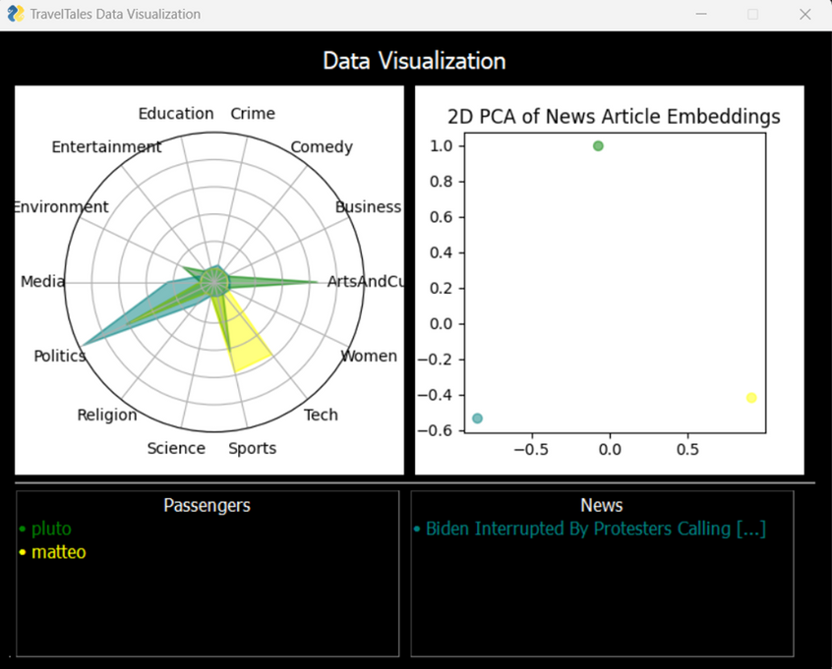
Client - Data Visualization Module
18
Exposes a GUI window for data visualization after a news has been proposed to a group of passengers.
The window includes two plots:
Radar Diagram
PCA Plot
highlight the correlation between the users’ interests (specified at registration time) and the categories within which the news is associated

Slide 19
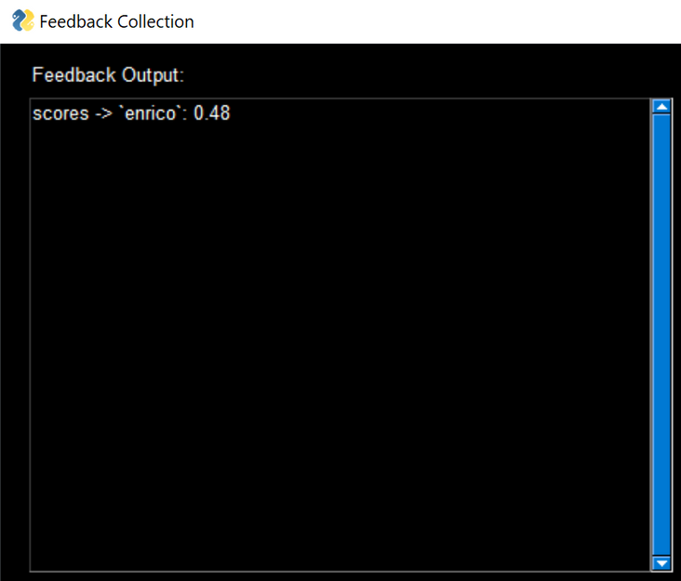
Client - Speaker Recognition Module (1/2)
19
Uses Picovoice Eagle library for real-time speaker recognition
Captures passenger speech during news discussions longer than 4.0 seconds that follow news proposal
Saves speech segments on disk for individual speakers
After 15.0 seconds of silence, merges multiple segments for the same person, create single long .wav files for each speaker

Slide 20
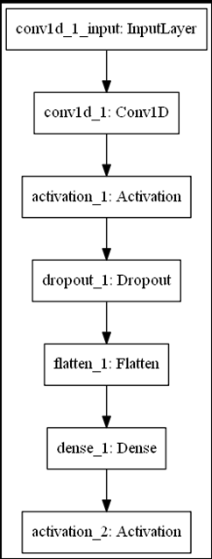
Client - Speaker Recognition Module (2/2)
20
Implements sentiment prediction files using a pre-trained Convolutional Neural Network (CNN)
Extracts essential audio-related features, specifically Mel-frequency cepstral coefficients (MFCC)
Enables efficient and accurate sentiment analysis directly from the audio content
Pretrained on english native speaker audio sentiment dataset (Dataset Link)

Slide 21
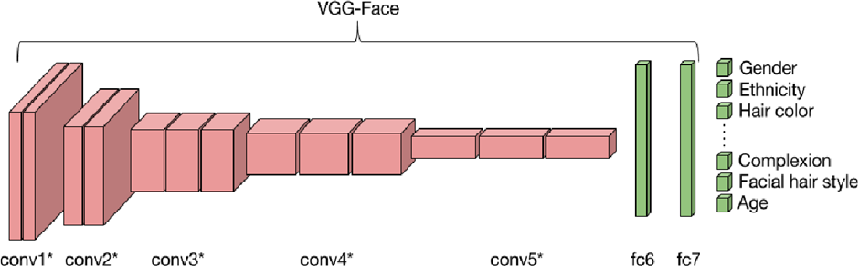
Client - Video sentiment analysis (1/2)
DeepFace:
Python library for face recognition and analysis
Default configuration uses the VGG-Face model
Applications in Video Sentiment Classification:
Detects multiple passengers and associates faces with voice profiles
Extracts emotional states in passengers
Validates sentiment predictions from Audio Sentiment Classifier
21

Slide 22
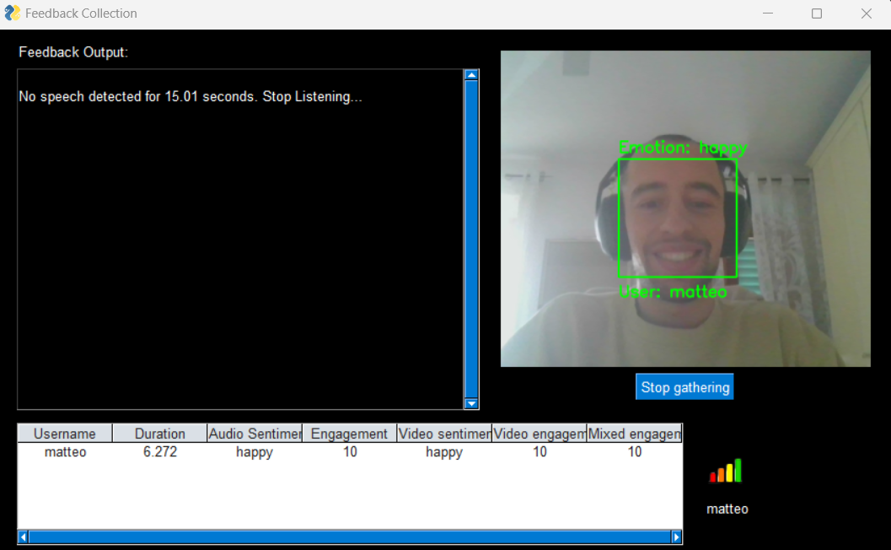
Client - Video Sentiment Analysis (2/2)
22
To better validate the audio sentiment classification, also a video sentiment classification is carried out, the following image shows a use case example

Slide 23
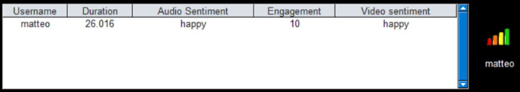
Client - Feedback Estimation Module (1/2)
23
Computes engagement feedback for proposed news
Utilizes heuristics based on:
Speech rate: ratio of non-silent frames to total frames
Audio Sentiment: sentiment analysis carried out on the speeches about the proposed news
Audio duration: total duration of audio in seconds

Slide 24

Client - Feedback Estimation Module (2/2)
24
A mapping is then defined to map sentiment labels to engagement score
2. Score adjustment based on different ranges of audio duration
Sentiment | Starting Engagement Score
neutral | 2
disgust | 2
calm | 3
angry | 5
fearful | 5
sad | 6
happy | 9
surprised | 10
3. Score adjustment by multiplying by the speech rate
Audio Duration Range | Engagement Score Adjustment
< 5 seconds | -1
10 - 15 seconds | +1
15 - 20 seconds | +2
>= 20 seconds | +3
4. The final engagement score is constrained within the range [1, 10]

Slide 25
Conclusion
25
Dynamic User Preferences: Future enhancement involves exploiting passenger feedback to refine personalized news suggestions
Continual Adaptability: This approach ensures constant optimization, aligning with evolving user preferences.
Challenges of system adaptation: the corret step size of user embeding adaptation can be set with a parameter tuning on unavailable dataset

